Slide 1
Module 3: Individual Peacekeeping Personnel
Lesson
3.12
Basic First Aid in the Field

Slide 2
Relevance
Timely medical emergency response important for survival
First Aid is applicable to everyday life
UN Core Pre-Deployment Training Materials 2017

Slide 3
Learning Outcomes
Learners will:
Define Basic First Aid
Explain actions to take as first responder to a medical emergency
Describe key First Aid responses
UN Core Pre-Deployment Training Materials 2017

Slide 4
Lesson Overview
Basic First Aid
The Chain of Survival
First One to Respond to a Medical Emergency
Actions Before First Aid Response
Key First Aid Responses
UN Core Pre-Deployment Training Materials 2017

Slide 5
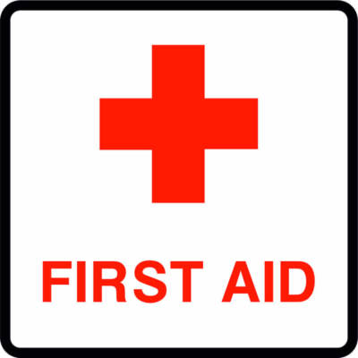
1. What is Basic First Aid?
Immediate care given to an injured or suddenly ill person
Does NOT take the place of proper medical treatment
Legal considerations – consent, trained personnel, peculiarities of the injured/ill person
UN Core Pre-Deployment Training Materials 2017
Notes:
Should this be in subtopic font/colour?

Slide 6
2. The Chain of Survival
In order for a person to survive:
Early
Inform/Call for Help
Early
First Aid/CPR
YOU
Early
Medical On Scene
Early
Advanced Care
(Hospital)
UN Core Pre-Deployment Training Materials 2017

Slide 7
3. If You are the First to Respond to a
Medical Emergency Incident…
Remain calm, do not panic
Assess situation
First Aid – permission, implied consent
Call for help
Stabilize situation
UN Core Pre-Deployment Training Materials 2017

Slide 8
4. Actions Before First Aid Response
Scene
Survey
Initial Assessment
Victim Assessment
First Aid Response
UN Core Pre-Deployment Training Materials 2017

Slide 9
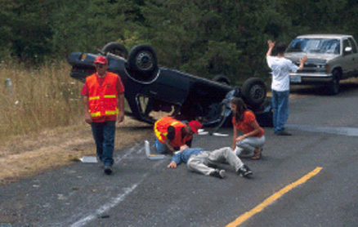
Scene Survey
Hazards
Cause
Number of victims
UN Core Pre-Deployment Training Materials 2017

Slide 10
Initial Assessment
A = Airway Open? (Head-tilt/chin-lift)
B = Breathing? (Look, listen, feel)
C = Circulation? (Check for signs of circulation)
UN Core Pre-Deployment Training Materials 2017

Slide 11
Victim Assessment Sequence
If victim is RESPONSIVE
Ask what injuries or difficulties
If victim is UNRESPONSIVE
Observe for obvious signs of injury or illness – check from head to toe
Provide First Aid/CPR
Check and provide First Aid
UN Core Pre-Deployment Training Materials 2017
Notes:
Should this be subheading font/colour? Combine into one heading?

Slide 12
5. Key First Aid Responses
First Aid Responses to… | Bleeding | Shock | Burns
Choking | Fractures and dislocation | Heart attack | Wounds
Amputation | Spinal injuries | Stroke | Bites and stings
UN Core Pre-Deployment Training Materials 2017

Slide 13
Summary of Key Messages
First Aid
Actions to take as first responder to a medical emergency
Key First Aid responses
UN Core Pre-Deployment Training Materials 2017

Slide 14
Questions
UN Core Pre-Deployment Training Materials 2017

Slide 15
Learning Activity
Learning Evaluation
UN Core Pre-Deployment Training Materials 2017

